Slide 1
Data Visualization
Dr. Eli T. Brown
DePaul University

Slide 2
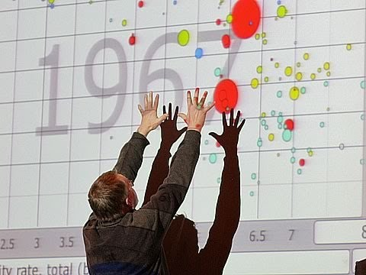
Hans Rosling and the Rise of Visualization
This guy helped show the world the possibilities of visualization:
Short and “3D”
https://youtu.be/jbkSRLYSojo
Longer w/ more detail https://youtu.be/hVimVzgtD6w
Gapminder
https://www.gapminder.org/tools/#_chart-type=bubbles
Hans Rosling

Slide 3

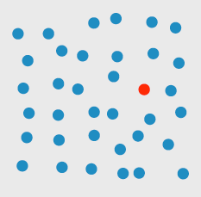
Why Visualization Works…

Slide 4
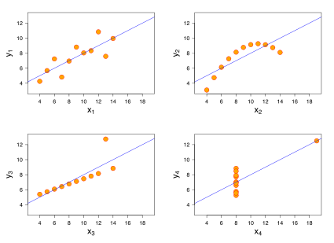
Why It’s Important

Slide 5
Why It’s Important
Property | Value
Mean of x | 9 (exact)
Sample variance of x | 11 (exact)
Mean of y | 7.50
Sample variance of y | 4.122 or 4.127
Correlation between x and y | 0.816
Linear regression line parameters | y = 3.00 + 0.500x

Slide 6
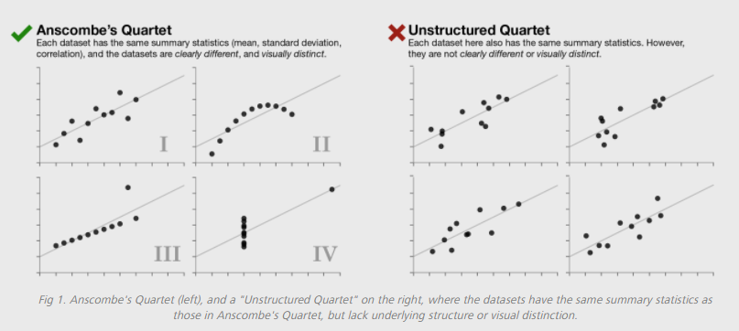
Not Just Super-Contrived Examples

Slide 7
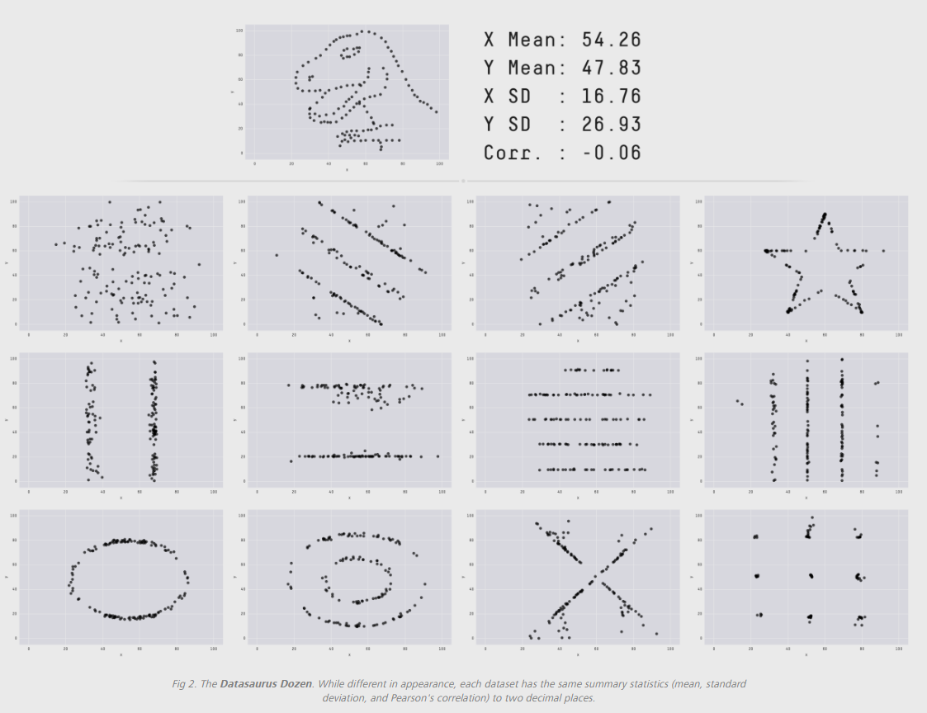
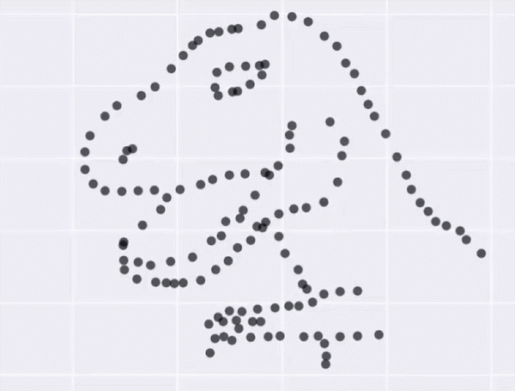
Fun Ones Too!

Slide 8
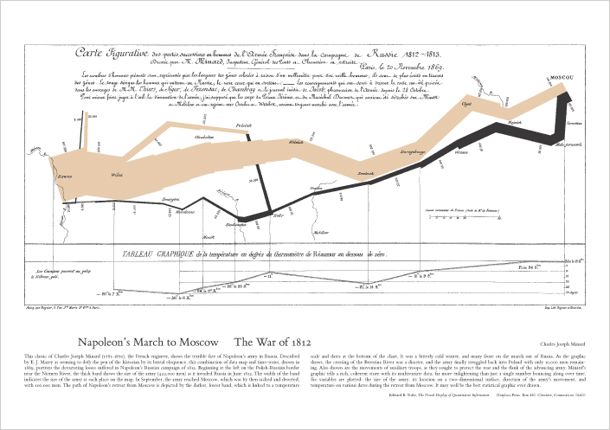
Excellent Visual Communication Example
Notes:
Excellent, historic example. This has several mappings of data to visual features and tells a story effectively.

Slide 9
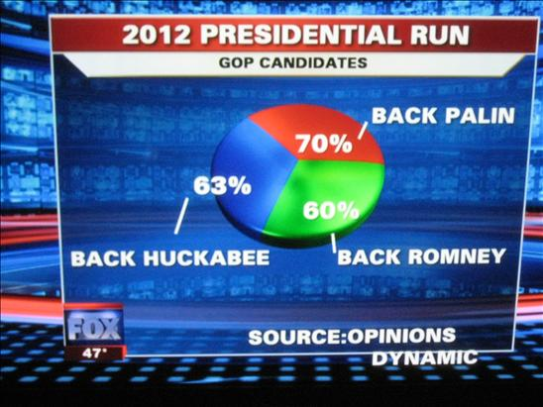
Bad Example
Notes:
Yikes – used a pie, extremely bright clashy colors, and most importantly, the pieces of the pie are percentages but don’t add up to 100 %

Slide 10
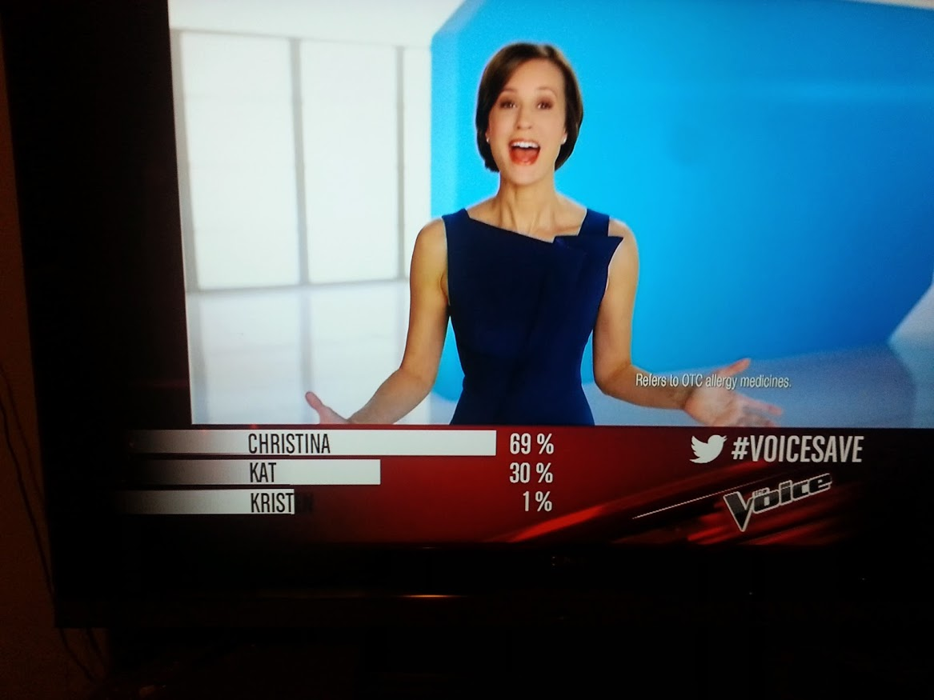
BAD ExamplE
Notes:
The bars are percentages and do add up, but the bar lengths are not correctly showing the values because there is a bunch of extra bar room to the left of the labels.

Slide 11
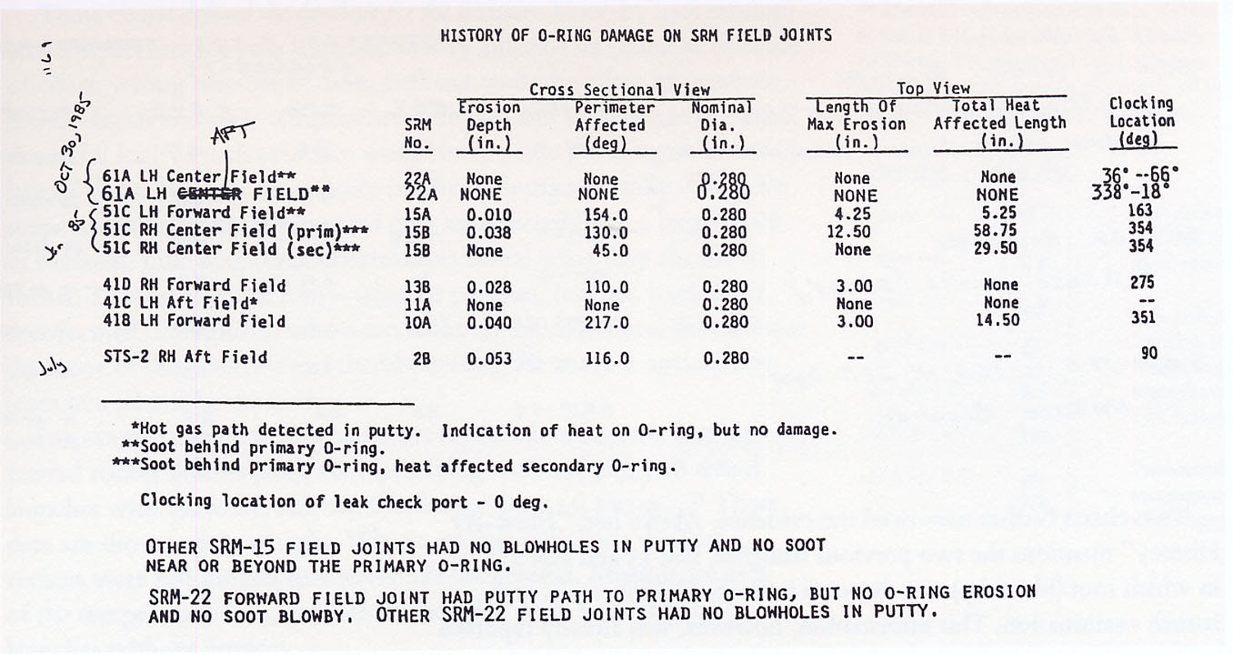
Reported O-ring damage table
Notes:
Here’s a view of some data collected about testing of a mechanical component

Slide 12
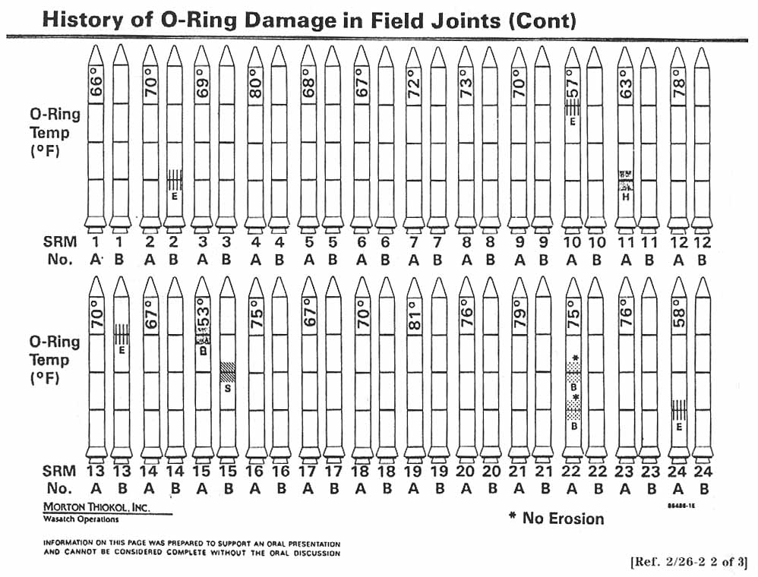
An visual explanation attempt
Notes:
Same basic data, visualized instead

Slide 13
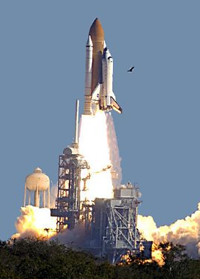
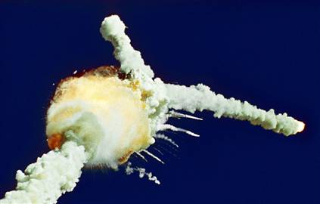
Results
Challenger Explosion

Slide 14
Fancy ≠ Good

Slide 15
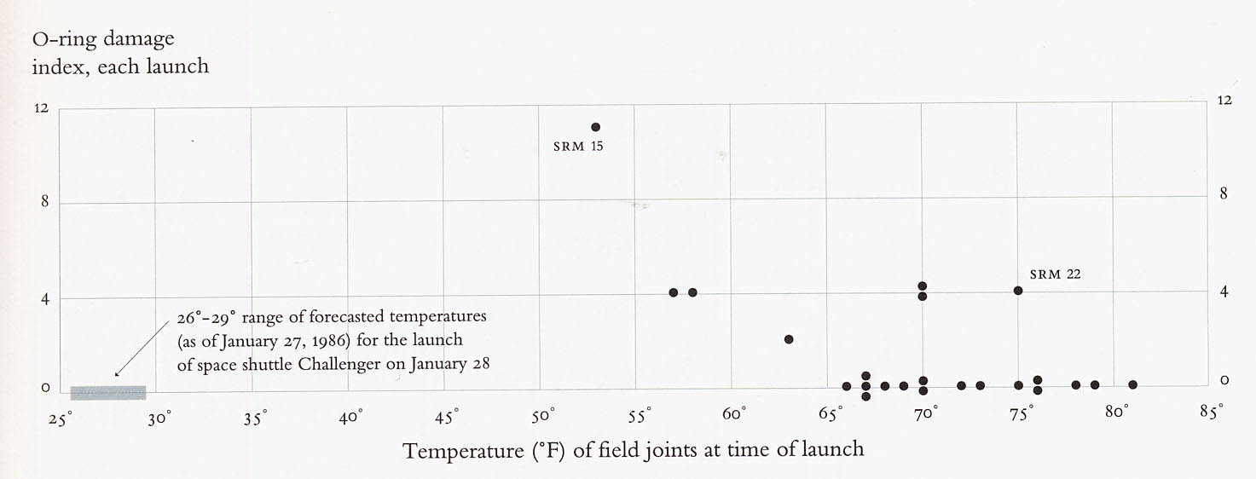
Graph the data
Edward Tufte
Notes:
Tufte is one of the cornerstone vis people, always arguing for clear and succinct graphics.

Slide 16
Visualization: When and How?
When
Use visualization to understand your data before machine analytics/statistics
Use it to understand complex, evolving relationships that are difficult or impossible to capture by machine
How
Map data to the screen with a question in mind
Draft and throw away visualizations repeatedly, like writing
Consider the issues and advice we discuss today; don’t lie with data
Target your audience

Slide 17
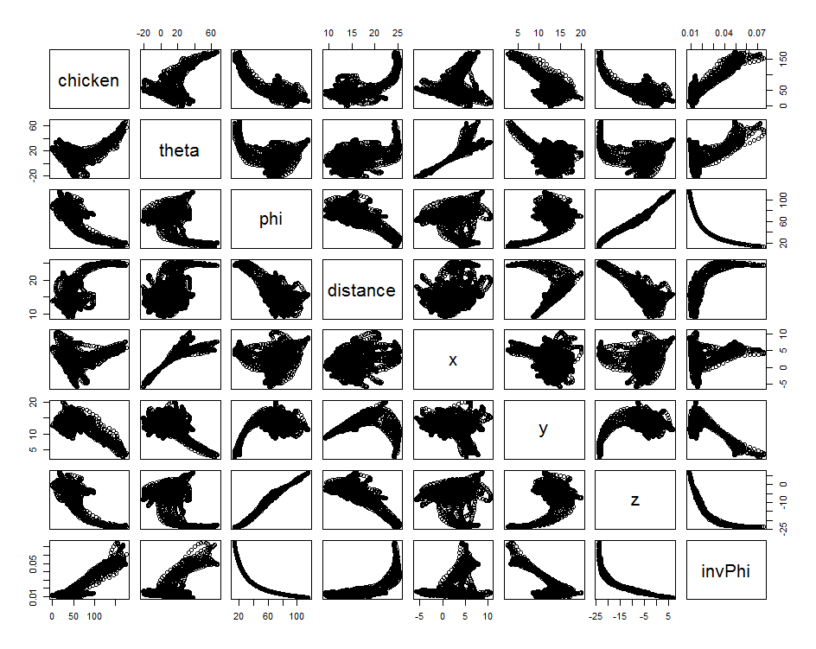
Types of Visualization
Exploratory
Gaining an understanding of data
Usually lots of graphs generated to examine relationships and patterns
Pay attention to perceptual issues but less emphasis on aesthetics
Explanatory
Communicating through visualization a result you already know
Tell a story
Pay attention to how the reader will interpret (or misinterpret) your visualization

Slide 18
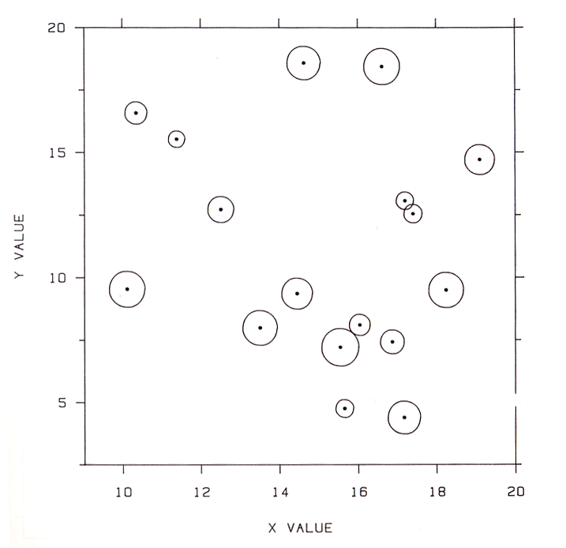
Graphical Perception
Visualization = data encoded symbolically
Perception is the reason a graph exists! “a graph is a failure if the visual decoding fails” - Cleveland
Cleveland and McGill showed a hierarchy for mapping numerical values

Slide 19
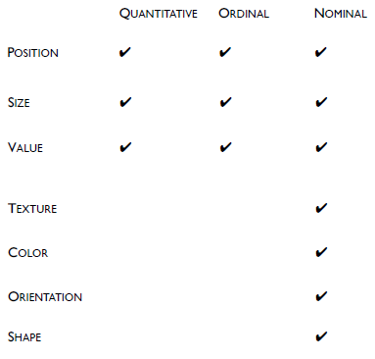
Visual Variables
From the seminal work of Jacques Bertin
Shows which types of data variables can be encoded with which types of visual mappings
Not every possible visual mapping is represented
There is a subtle thing about color though…
Slide courtesy of Sara Su

Slide 20
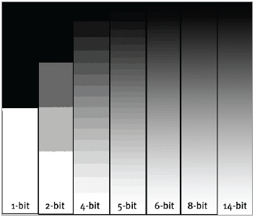
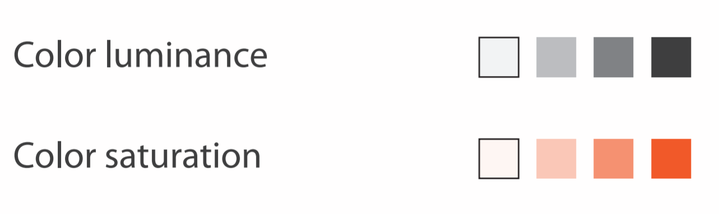
Value = Color Value (Intensity)
Discrete or Continuous?
from Munzner
courtesy of Sara Su

Slide 21
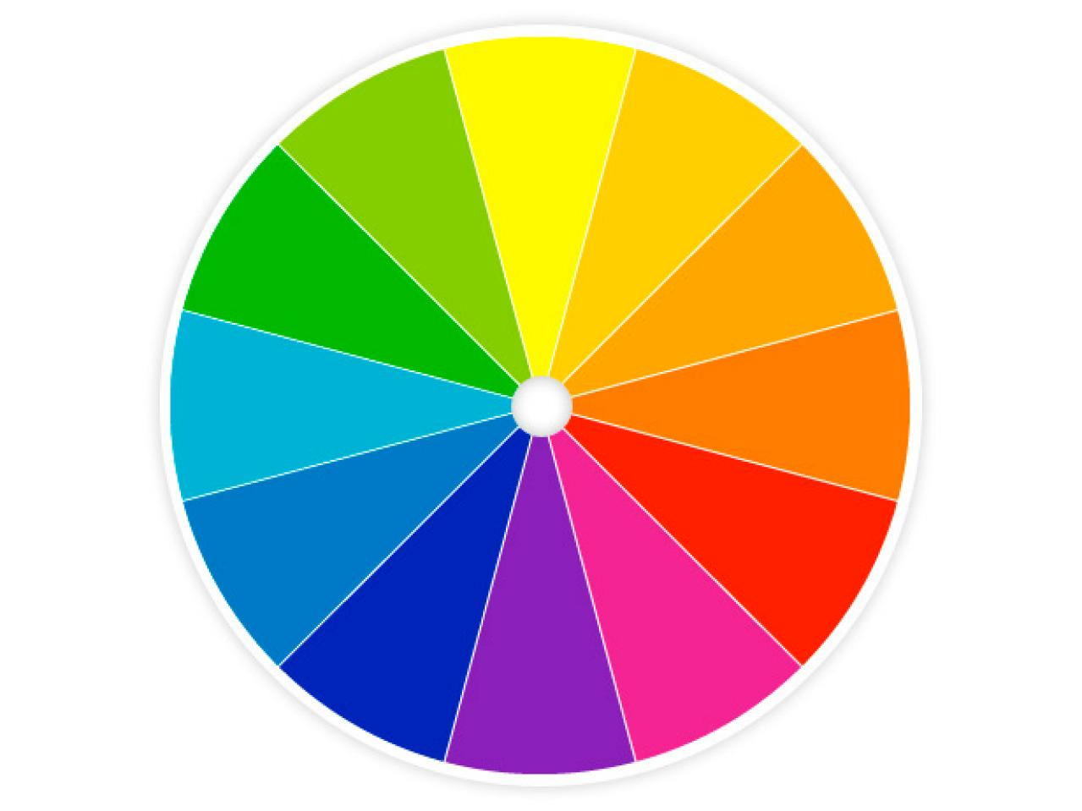
Color here means Hue
Discrete Only

Slide 22
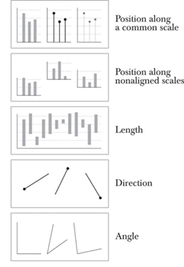
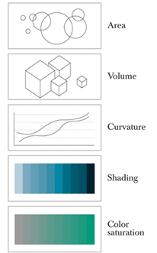
How well do these work?
Perceptual hierarchy (top to bottom, left then right)
Ability to decode is key
Strictly applies to decoding specific value
If we can’t decode accurately … does that mean we shouldn’t use it?
Cairo on Cleveland and McGill

Slide 23
Examples

Slide 24
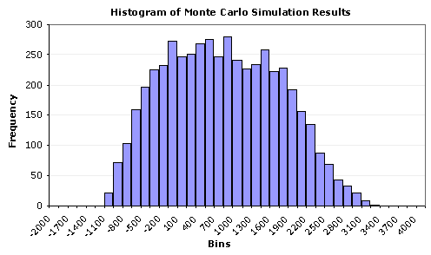
Examples

Slide 25
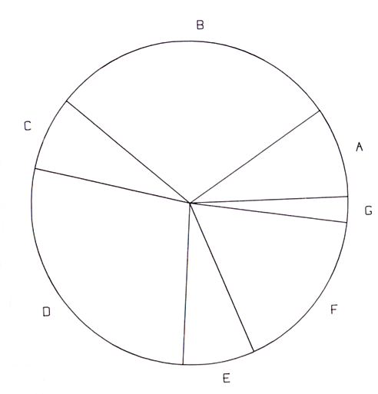
Examples

Slide 26
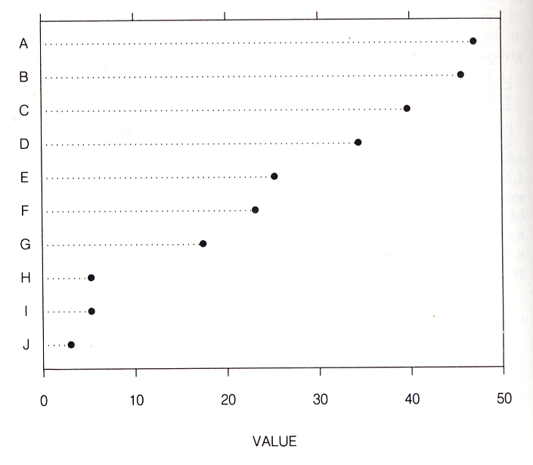
Examples

Slide 27
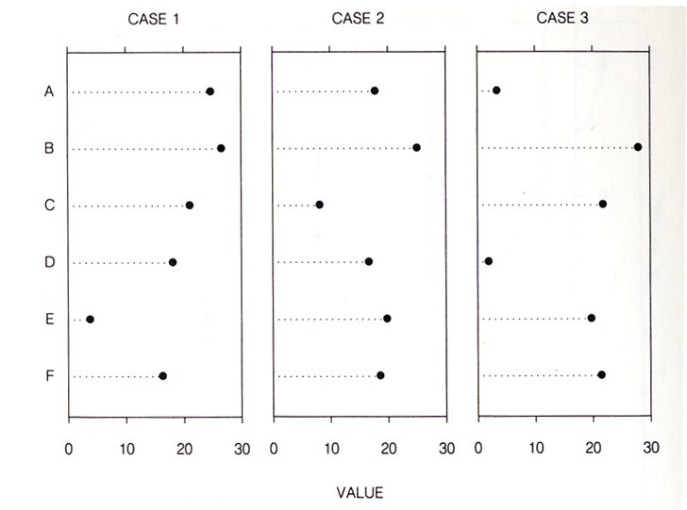
Examples

Slide 28
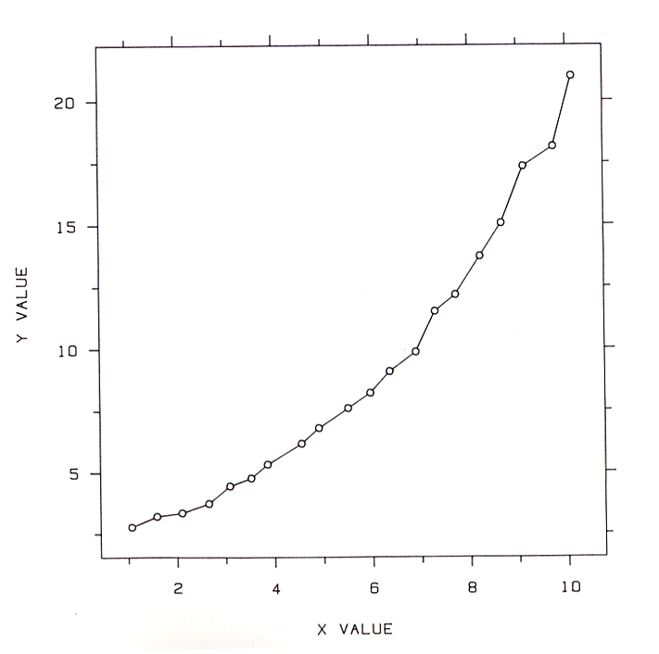
Examples

Slide 29
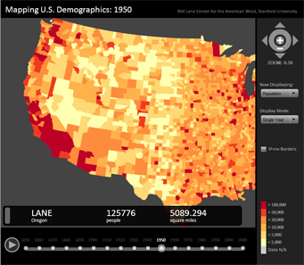
Examples

Slide 30
Perception Test
Visualization is about how we perceive graphs
Compare values encoded visually
Four values: A, B, C & D
B, C & D are each a percentage of A
Visually judge values without measuring (or holding up your hand to the screen ☺)
Gives you an idea of how hard these are

Slide 31
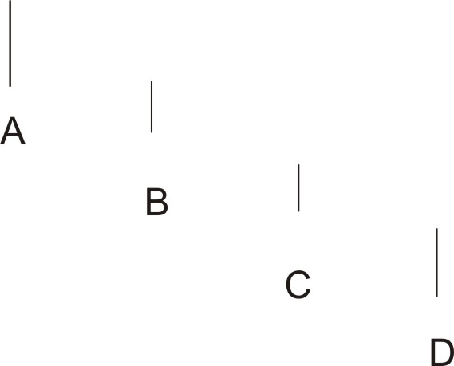
Length Non-Aligned Test 1

Slide 32
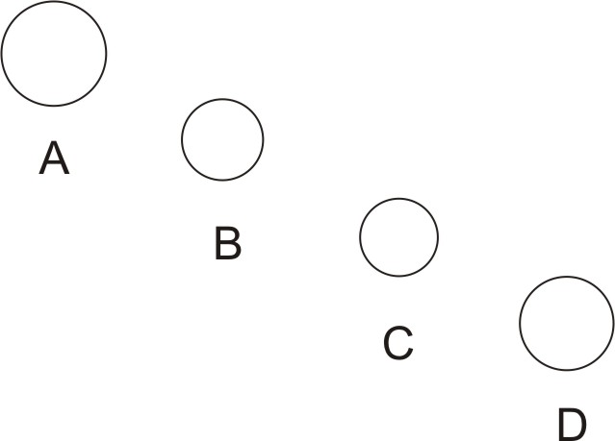
Area Test 1

Slide 33
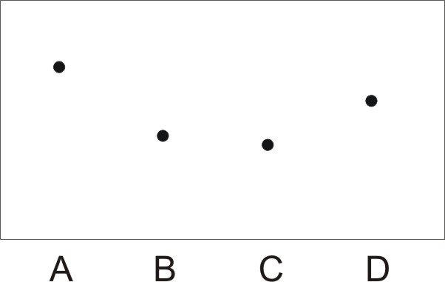
Vertical Distance Common Baseline Test 1

Slide 34
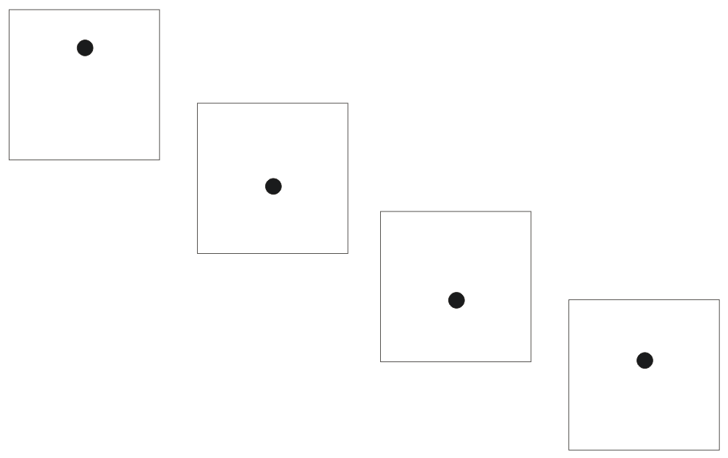
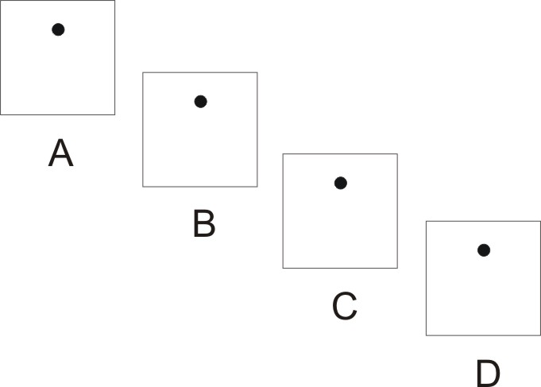
Vertical Distance Non-Aligned Test 1
A
B
C

Slide 35
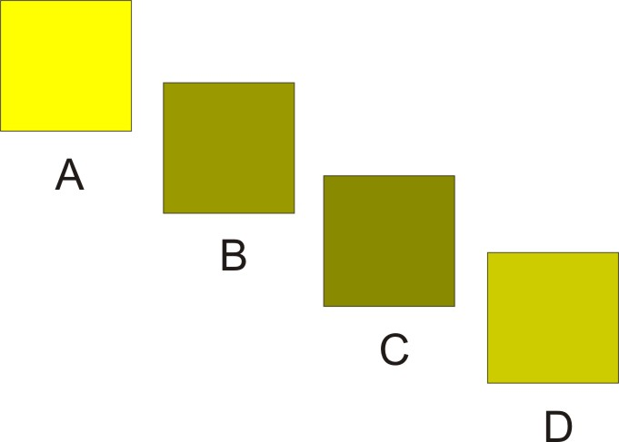
Color (Luminosity) Test 1

Slide 36
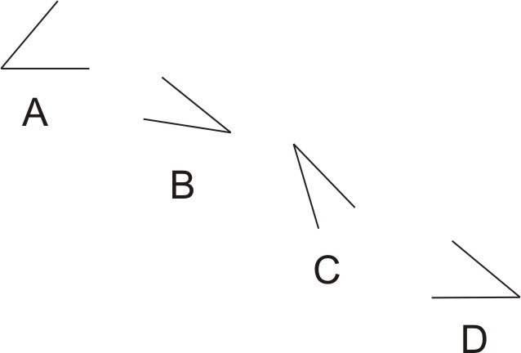
Angle Test 1

Slide 37
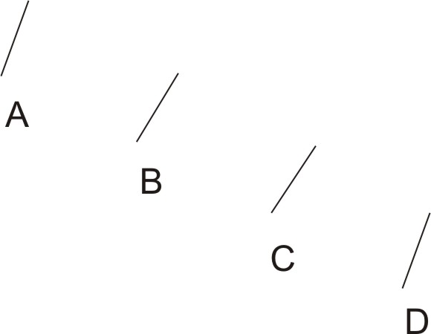
Slope Test 1

Slide 38
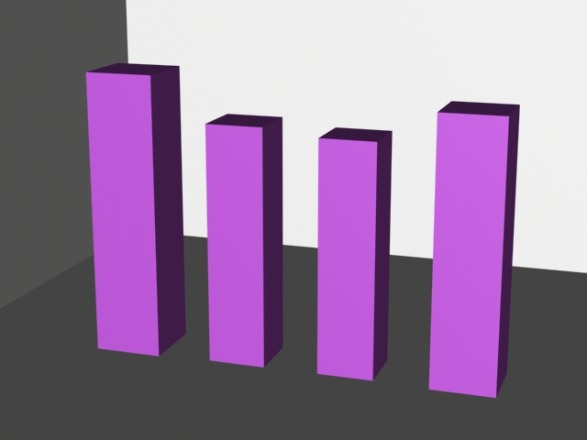
Volume Test 1

Slide 39
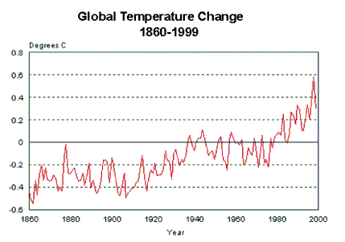
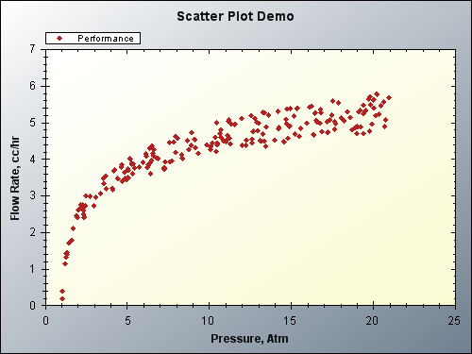
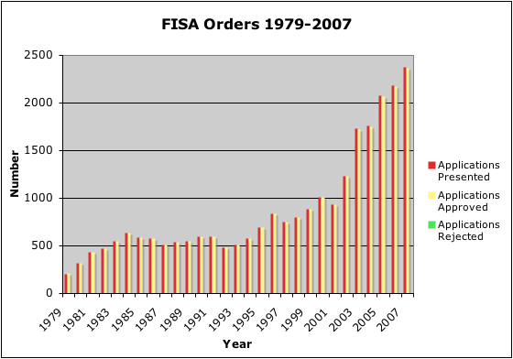
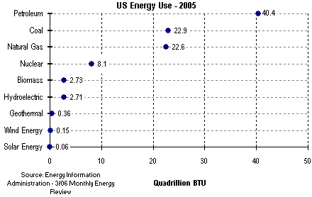
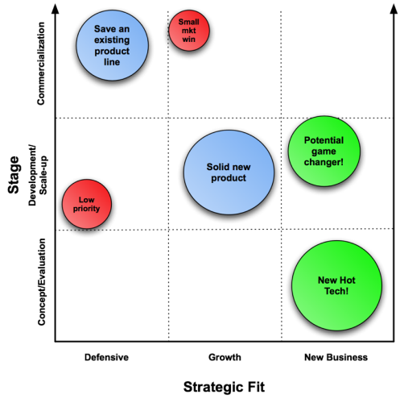
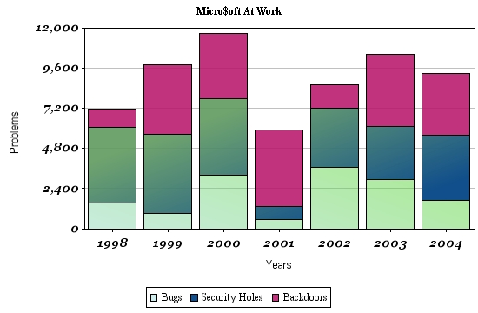
Basic Graph Types
Line
Scatter Plot
Column (bar)
Dot-Chart (like horizontal bar)
Stacked Bar
Area
Bubble

Slide 40
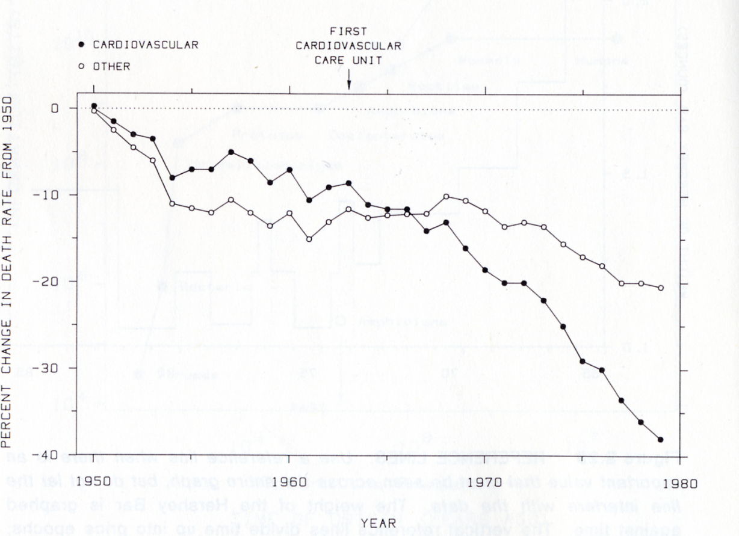
Line Graphs
Points are connected
Connections have meaning
Continuous change and rate of change

Slide 41
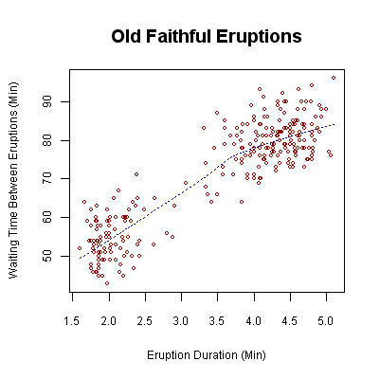
Scatter Plots
Data are not a series
May be more than one y-value for each x-value
Stochastic data

Slide 42
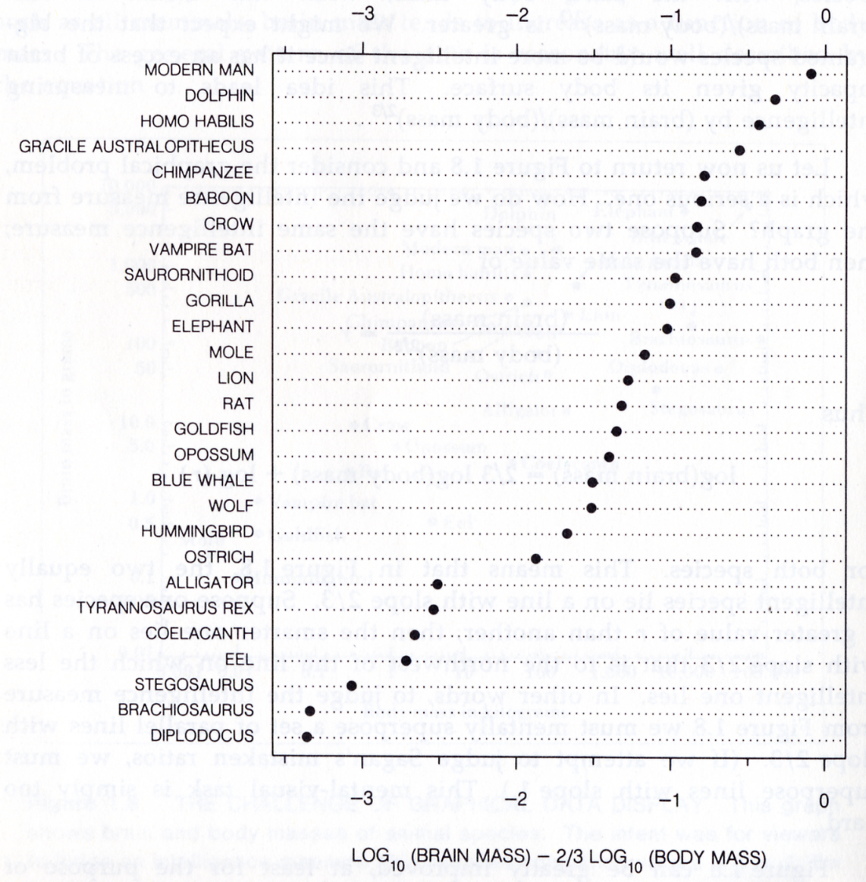
Ordering is often critical!
For categorical axes, never blindly use the default order
The order should follow some aspect of the data
Unless alphabetical order is important for reading the graph!

Slide 43
Exercise
How many variables can you fit into a line graph?
What about a bar chart?
Compare to scatter plot?
For 2-dimensional data, are these three visualizations the same?

Slide 44
Exercise
Scatter / Bar / Line have different uses
Scatter can have multiple Y values at the same X
Line implies some connection
Bar is (generally) the best option for categorical data in X

Slide 45
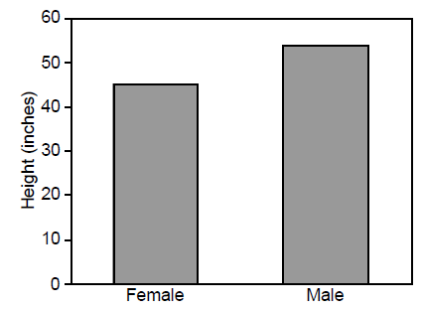
Bar vs Line
Image courtesy of Barbara Tversky

Slide 46
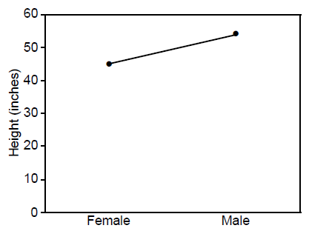
Bar vs Line
Image courtesy of Barbara Tversky

Slide 47
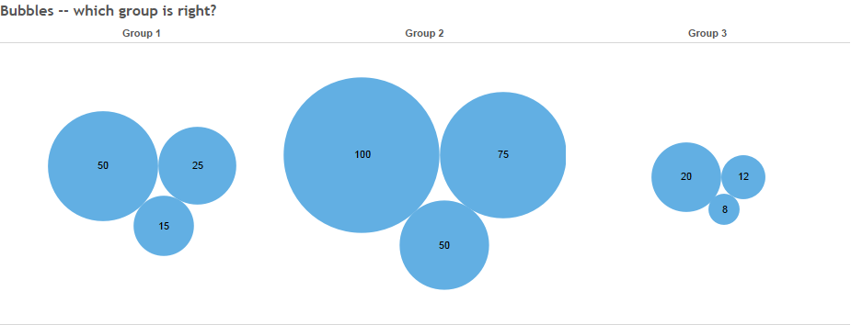
Which data are graphed correctly?
http://www.datarevelations.com/circles-labels-colors-legends-and-sankey-diagrams-ask-these-three-questions.html
Notes:
Group 1 is correct, but that’s not really the point – you can’t tell.

Slide 48
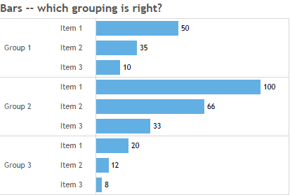
Which data are graphed correctly?
http://www.datarevelations.com/circles-labels-colors-legends-and-sankey-diagrams-ask-these-three-questions.html
Notes:
Group 1 is correct, but that’s not really the point – you can’t tell.

Slide 49

Revisiting Packed Bubbles
http://www.datarevelations.com/circles-labels-colors-legends-and-sankey-diagrams-ask-these-three-questions.html

Slide 50

Hierarchical Bar
http://www.datarevelations.com/circles-labels-colors-legends-and-sankey-diagrams-ask-these-three-questions.html

Slide 51
Principles for Good Visualizations
Principles for Graphical Integrity, from Tufte (abbreviated list)
Representation of numbers as physically measured on the graphic (amount of ink) should be directly proportional to the actual numerical quantity.
Clear, detailed, and thorough labelling should be usd to defeat distortion and ambiguity. Include explanations and labels of important events.
For time series about money, always normalize for inflation
Do not show data out of context
Also, will add – for data where population is a factor, normalize with ‘per capita’

Slide 52

Consider this Example

Slide 53
Remove junk and adjust for inflation

Slide 54
Aspect ratio and exaggeration
Remember: the aspect ratio of the graph is under our control!

Slide 55
The banking to 45° “Rule”
Aspect ratio set for median 45° slope
Often yields better slope comparisons

Slide 56
Data Distortion

Slide 57
Include More data
What about neighboring states?

Slide 58
Compare

Slide 59

Example
Purchasing power of the dollar displayed by size
Example from Edward Tufte

Slide 60
Perception?
Human perception muddies the water here a bit
Two variables (width, height) represent the same thing
Brain sees area, but the area differences are way off (2x for 1978)

Slide 61

Problem with This Graph?

Slide 62


Data Distortion!

